Slide 1
Guided Capstone – Big Mountain Resort

Slide 2
Problem identification – Problem Context
The resort suspected itself is not fully capitalizing on its facilities.
The resort has no good sense on the importance of different facilities
The resort can not strategically set up their ticket price and adjustment on facilities
The resort may under/overcharge customers and open expensive unpopular facilities.
In other words, the resort may
lose great amount of profit!

Slide 3
Problem identification – Scope of solution
1) Build up a model based on information of different similar resorts to:
Study how customers value different types of facilities
Predict ticket price under different scenarios of Big Mountain Resort (Adjustment of facilities)
2) Estimate the new revenue and operating cost and hence the new profit of the resorts

Slide 4
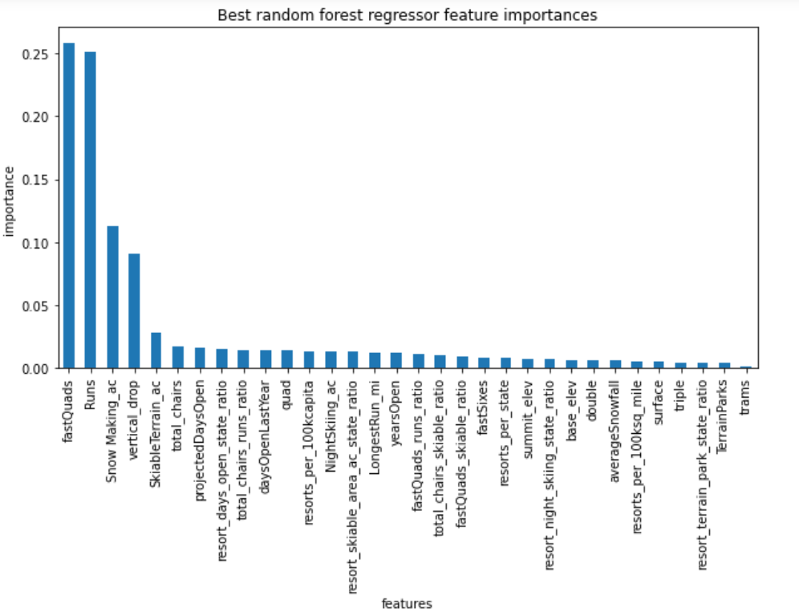
Modeling results and analysis - The 4 most importance attributes affecting ticket price
Fastquads
Runs
Snow making area
Vertical drop

Slide 5
Modeling results and analysis – Predicted Ticket Price
Predicted Ticket Price by Model ($) | Current Ticket Price ($)
95.87 | 81.00
The model result indicates the resort is currently undercharging
The main reason is the quality of facilities provided the resort is high
The model can also predict the ticket price upon different scenarios
(e.g. 2 runs can be added/dropped and predict new ticket price)

Slide 6
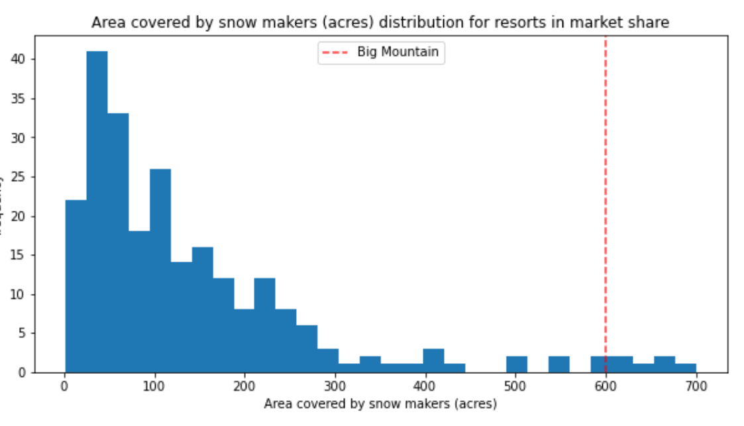
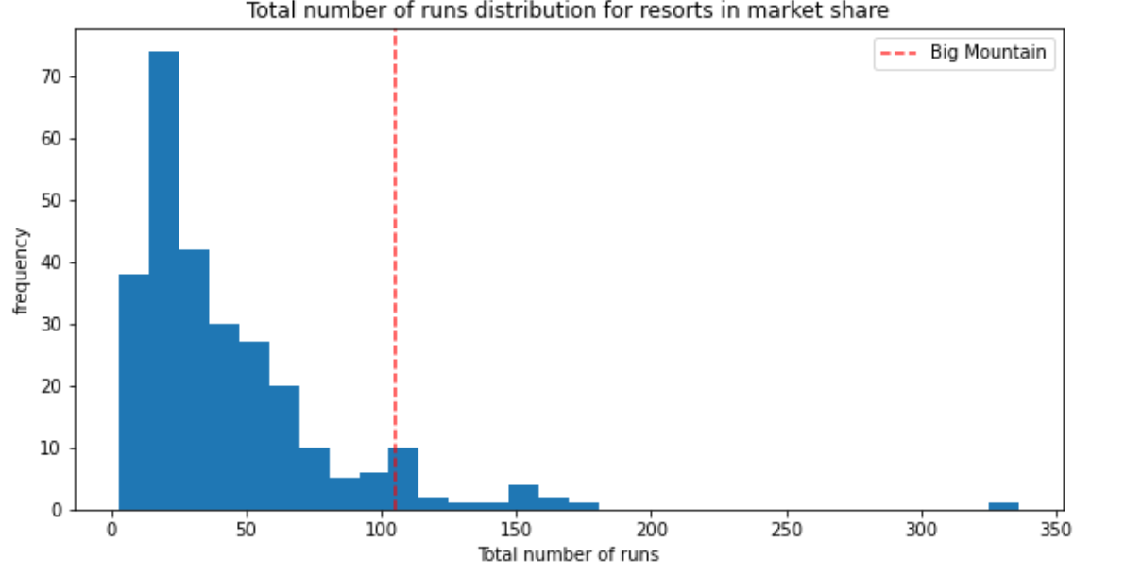
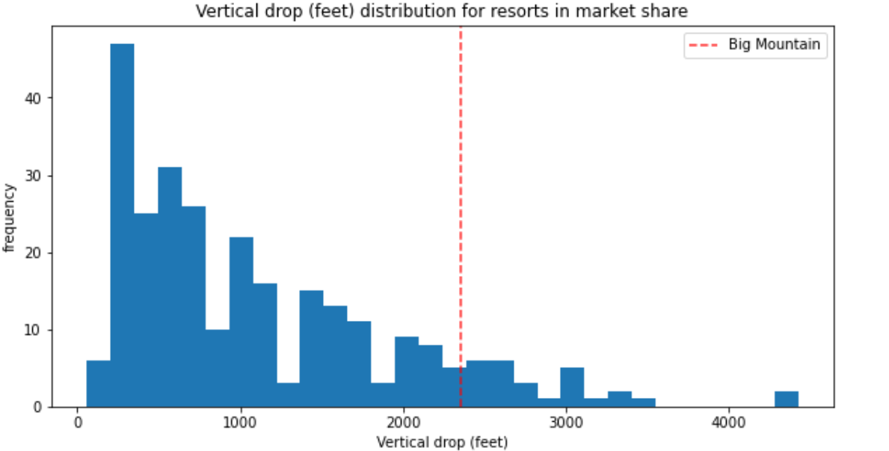
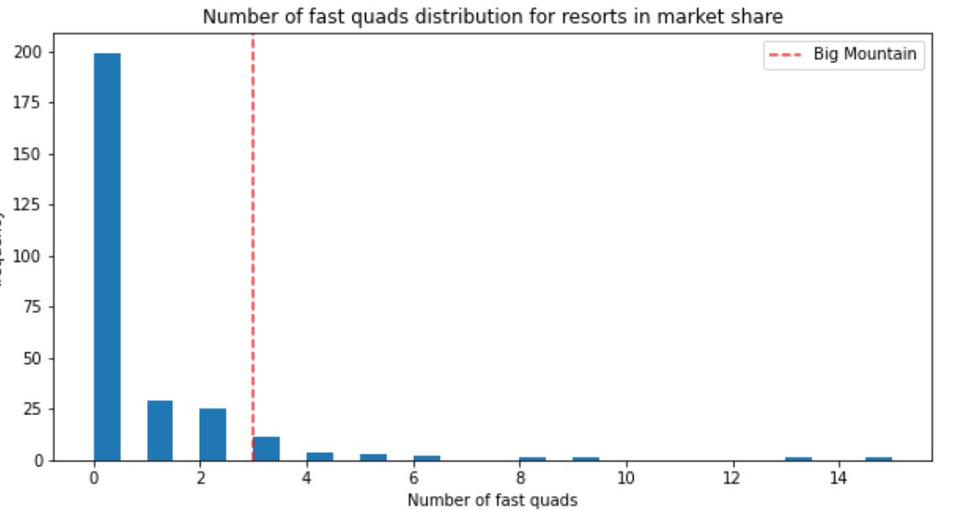
Red lines indicated the resort’s performance and demonstrated the resort quality

Slide 7
Recommendation
Figure out the most unpopular runs and their related facilities.
Work out different combination of facilities to be closed/added
Optimize predicted profit by re-calculating operating cost and ticket revenue
Predict new ticket price from the model

Slide 8
Conclusion and Further Studies
1) The function of current model include:
Figures out the most importance features affecting the ticket price
Demonstrates the resort is currently undercharging based on the quality of its service/facilities
Can predict of new ticket price if we add or close different facilities from the resort
2) For further studies, data including operating cost of all facilities and no. of customers are required
3) Another model can be built to predict no. of customers and the duration they will stay

